Slide 1

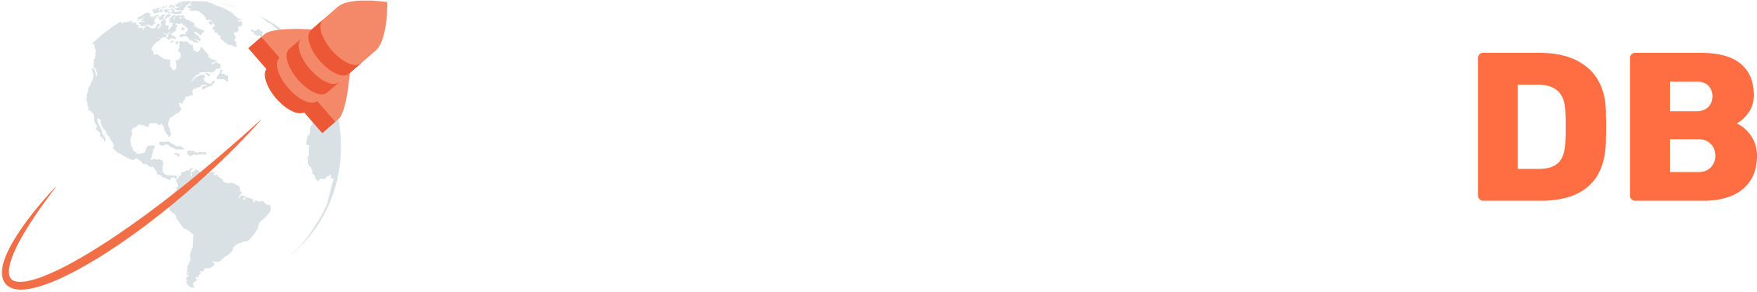
Introducing YugabyteDB
A high performance, distributed SQL DB built for the cloud

Slide 2
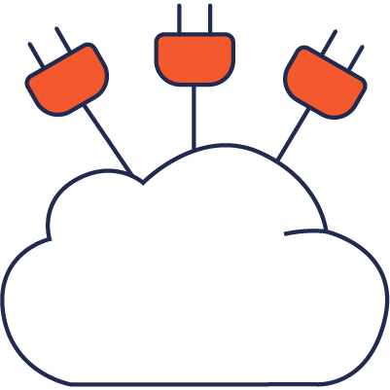
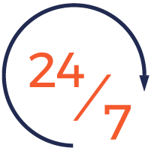


What is Distributed SQL?
A Revolutionary Database Architecture
SQL
SQL & Transactions
Ultra Resilience
Massive Scalability
Geo Distribution

Slide 3
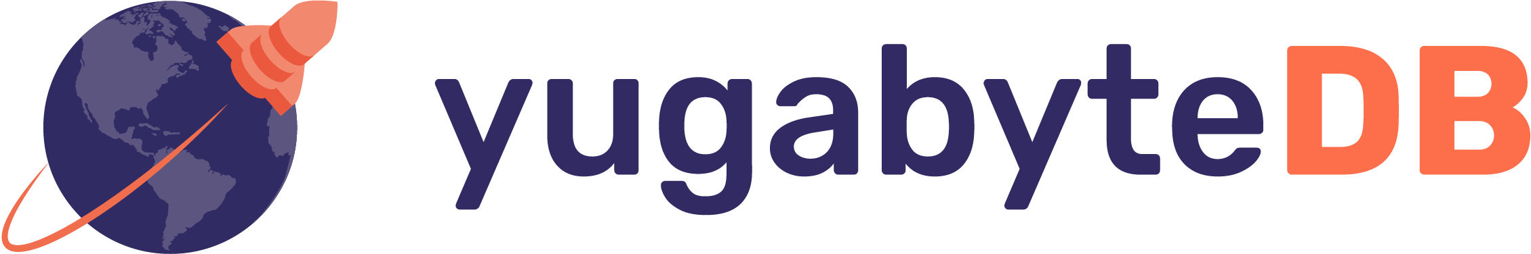
= distributed SQL database
+ high OLTP performance (low Latency)
+ cloud native (run on Kubernetes, VMs, bare metal)
+ open source (Apache 2.0)

Slide 4

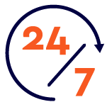


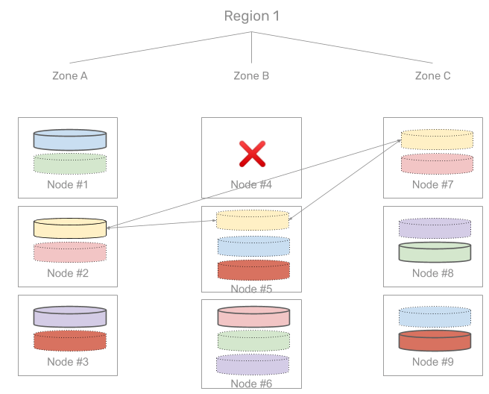
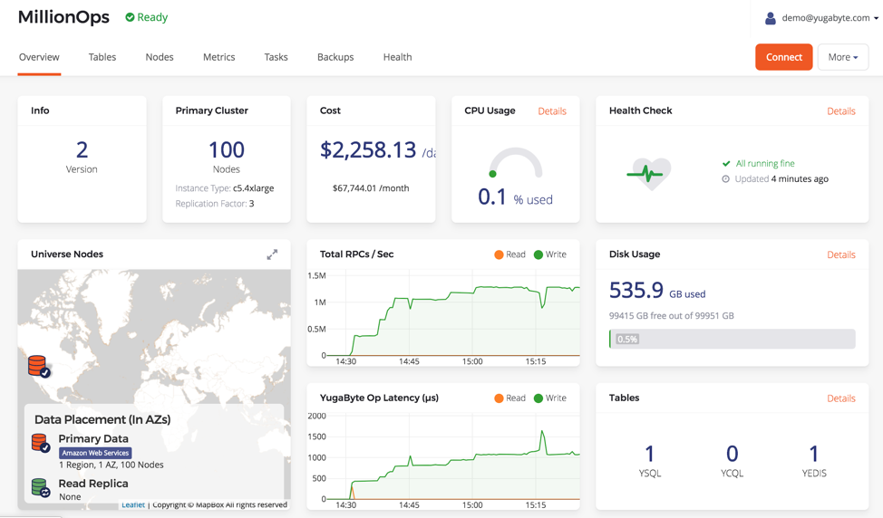
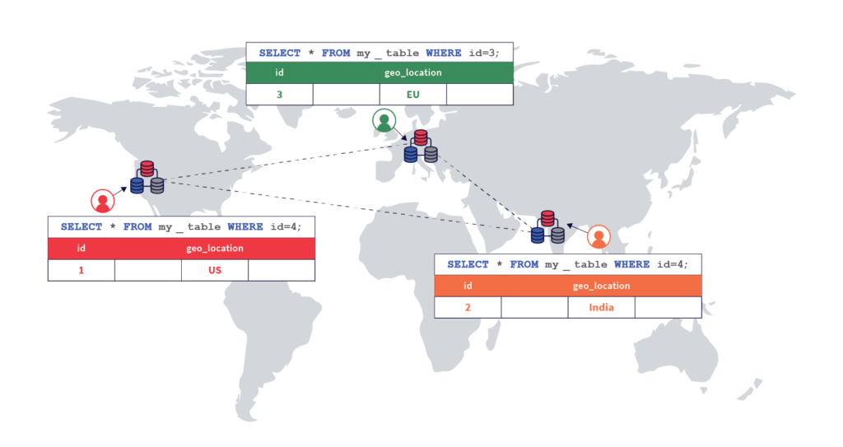
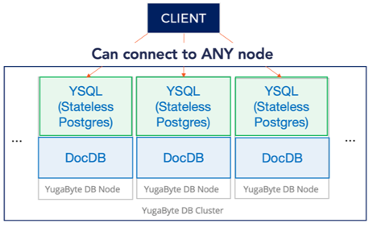
YugabyteDB Key Features
PostgreSQL Compatible
Resilience & HA
Horizontal Scalability
Geo-Distribution
Reuses the query layer of PostgreSQL
Offers advanced features (triggers, stored procedures, partial indexes, security, etc)
Build / modernize apps with high agility
Developers get instantly productive
Migrate legacy DBs to the cloud (Oracle / RAC, SQL Server, DB2)
Example: A large bank migrated from DB2, Justuno from SQL Server
Survives multiple failures - nodes, zones, regions/data centers
Auto-heals with re-replication
Zero-downtime upgrades & security patching
Proven in real-world scenarios at scale
Eg: Sep’19 Plume continued handling billions ops/day during AWS outage of EU zone. Multiple rolling upgrades and cluster expansions
Billions of ops/day, hundreds of TB
Scale queries, storage and connections by adding nodes
Reliably scale-out and scale-in on demand with large datasets without impacting the running application
Example: Kroger and Narvar scale-out YugabyteDB to handle peak traffic (Black Friday and Cyber Monday), can scale-in after holiday season
Distribute data across zones, regions or clouds with ACID consistency
Most complete global replication features of any database: sync, async, geo-partitioning, hybrid deployments
Move data closer to customers and comply with regulations like GDPR
Example: Admiral geo-distributed data across 5 regions and 3 continents to improve user experience by achieving < 3ms read latencies

Slide 5
Architecture

Slide 6
Components
YugabyteDB is composed of 3+ nodes
Universe
Cluster
Nodes - are machines, VMs, or containers
Nodes can be geographically
Cluster - is a logical group of nodes running YugabyteDB servers
Universe is composed of one or more clusters
User tables
Cluster
Node
Node
Node
User tables
Node
Node
Node
Cluster
User tables
Node
Node
Node

Slide 7
Layered Architecture
YugaByte SQL (YSQL)
PostgreSQL-Compatible Distributed SQL API
YugaByte CQL (YCQL)
Cassandra-Compatible Semi-Relational API
DocDB
Spanner-Inspired Distributed Document Store
Cloud Neutral: No Specialized Hardware Needed

Slide 8
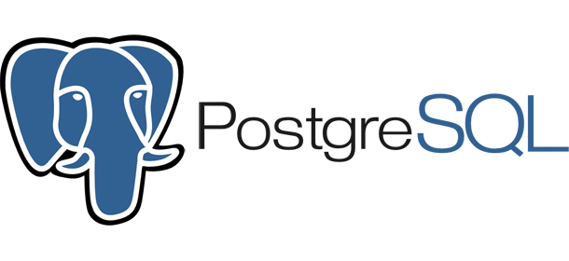
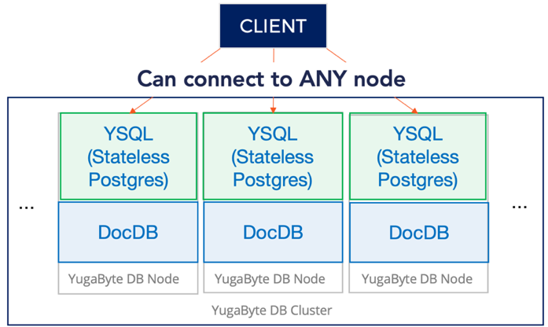
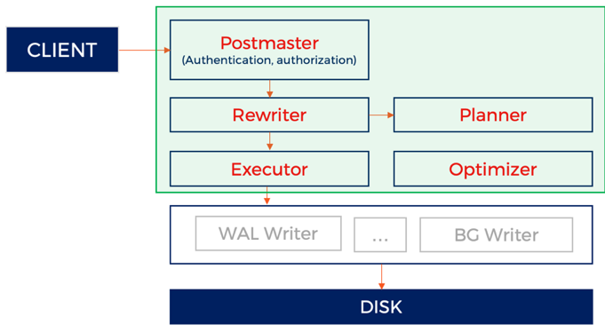
PostgreSQL Transformed into Distributed SQL

Slide 9
Existing PostgreSQL Architecture
Reuse
PostgreSQL Query Layer
SQL APP
Postmaster
(Authentication, authorization)
Rewriter
Planner
Executor
Optimizer
WAL Writer
…
BG Writer
DISK

Slide 10
DocDB as Storage Engine
SQL APP
Postmaster
(Authentication, authorization)
Rewriter
Planner
Replace table storage with DocDB
Executor
Optimizer
…
YugaByte DB Node
YugaByte DB Node
YugaByte DB Node
…

Slide 11
Make PostgreSQL Run on Distributed Store
SQL APP
Postmaster
(Authentication, authorization)
Enhance planner, optimizer, and executor for distributed DB
Rewriter
Planner
Executor
Optimizer
…
YugaByte DB Node
YugaByte DB Node
YugaByte DB Node
…

Slide 12
All Nodes are Identical
SQL APP
Can connect to ANY node
Add/remove nodes anytime
…
…
Stateless
Postgres
Stateless
Postgres
Stateless
Postgres
DocDB
DocDB
DocDB
YugaByte DB Node
YugaByte DB Node
YugaByte DB Node

Slide 13

Resilience to Failures
SQL APP
App not affected by
node failures
Stateless tier
connect to any live node
…
Stateless
Postgres
Stateless
Postgres
Stateless
Postgres
…
DocDB
DocDB
DocDB
Fault tolerant
can survive node failures
YugaByte DB Node
YugaByte DB Node
YugaByte DB Node

Slide 14
DocDB Architecture

Slide 15
DocDB :
Sharding

Slide 16
Monolithic Databases vs Distributed Databases
What Monolithic databases do
Serve queries from a single node
Scale up vertically
Cannot tolerate failures to the primary node
Need additional software for HA and DR
What Distributed databases do
Serve queries on every node
Scale out horizontally
Tolerate failures to any node
Built-in HA and DR
clients
clients
clients
CPU
RAM
Vertically
Scale
CPU
RAM
CPU
RAM
CPU
RAM
CPU
RAM
CPU
RAM
DB
...
DB
DB
DB
DB
DB
Node
Node + CPU & RAM
Node
Node
Node
Node

Slide 17
How do Distributed Databases Scale Out
You shard the data and spread the shards across nodes so load is distributed
No single node holds all the data
clients
clients
CPU RAM
CPU RAM
CPU RAM
CPU RAM
CPU RAM
shard1
shard1
shard2
shard2
shard3
shard3
shard4
shard4
node
node
node
node
node
cluster

Slide 18
How do Distributed Databases Tolerate Failures
You shard the data and spread the shards across nodes so load is distributed
With 4 nodes and RF=3, you can lose 2 nodes and have a full data set
clients
clients
CPU RAM
CPU RAM
CPU RAM
CPU RAM
CPU RAM
shard1
shard1
shard1
shard1
shard2
shard2
shard2
shard2
shard3
shard3
shard3
shard3
shard4
shard4
shard4
shard4
node
node
node
node
node

Slide 19
Every Table is Automatically Sharded
… | … | …
… | … | …
… | … | …
… | … | …
… | … | …
SHARDING = AUTOMATIC PARTITIONING OF TABLES
tablet 1’

Slide 20
Supports multiple sharding strategies
Hash Sharding
Ideal for massively scalable workloads
Distributes data evenly across all the nodes in the cluster
Range Sharding
Efficiently query a range of rows by the primary key values
Example: look up all keys between a lower and an upper bound

Slide 21
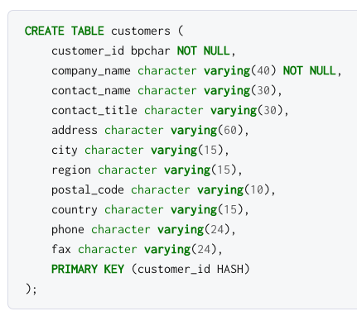
Hash Sharding Examples

Slide 22
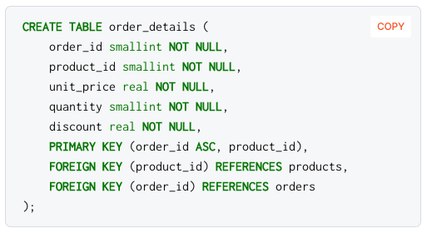
Range Sharding Examples

Slide 23
DocDB :
Replication
DocDB uses Raft consensus to replicate data
https://raft.github.io/

Slide 24

Dynamic Membership Changes
Raft Leader
On adding a node, it gets added to the Raft group
tablet 1’

Slide 25
Dynamic Membership Changes
Raft Leader
Replication factor of the tablet temporarily goes to 4
tablet 1’

Slide 26
Dynamic Membership Changes
Raft Leader
Data gets replicated to the newly added node
tablet 1’

Slide 27
Dynamic Membership Changes
Raft Leader
𝗫
An existing node is removed from the Raft group
tablet 1’

Slide 28
Dynamic Membership Changes
Raft Leader
Data is now stored on three different nodes, no downtime
tablet 1’

Slide 29
DocDB:
Deployment and Failover

Slide 30
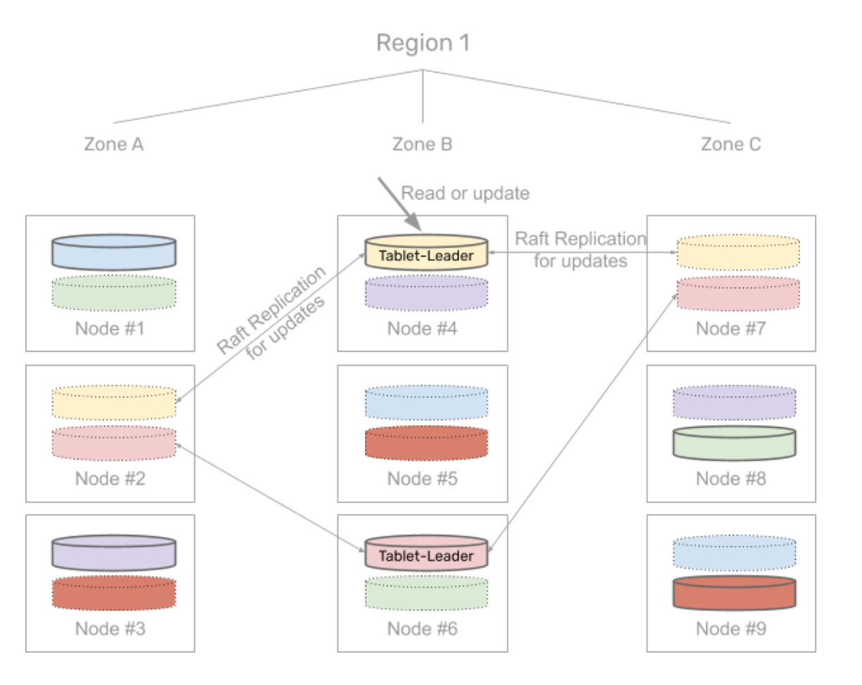
Multi-Zone Deployment
Multi-region is similar
6 tablets in table
Replication = 3
1 replica per zone

Slide 31
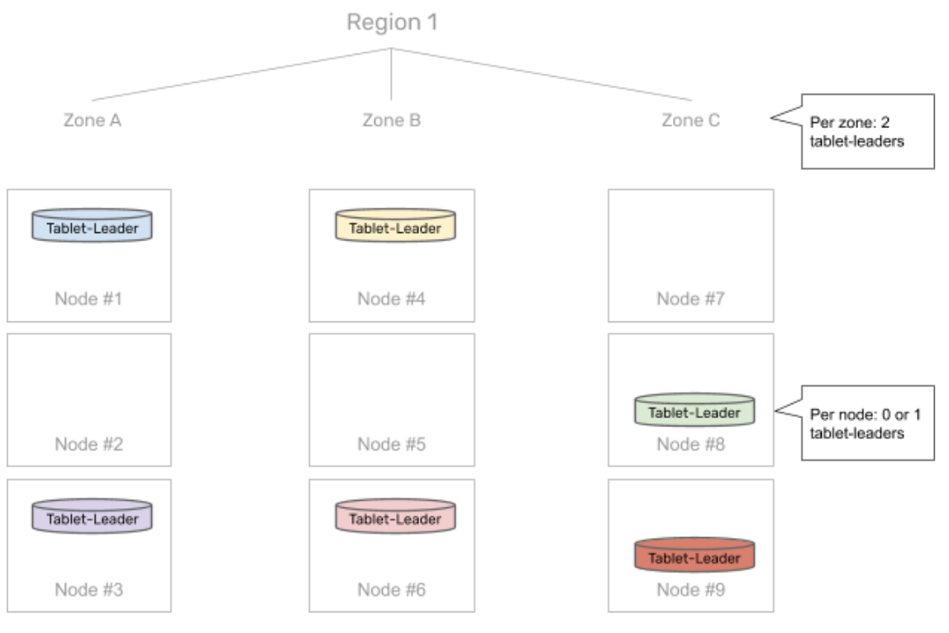
Balancing across zones and regions
Tablet leaders balanced across:
Zones
Nodes in a zone
Per-table balancing

Slide 32
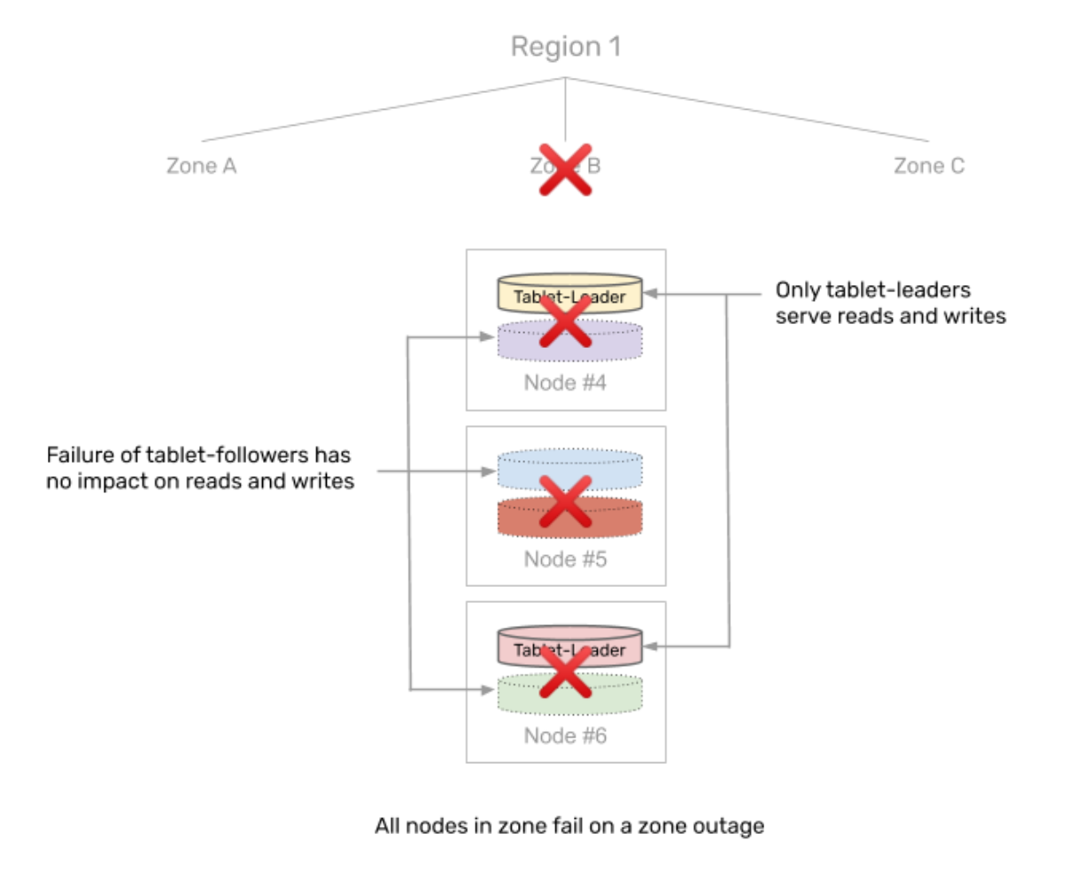
Tolerating Zone Outage
New tablet leaders re-elected (~3 sec)
No impact on tablet follower outage
DB unavailable during re-election window
Follower reads ok

Slide 33
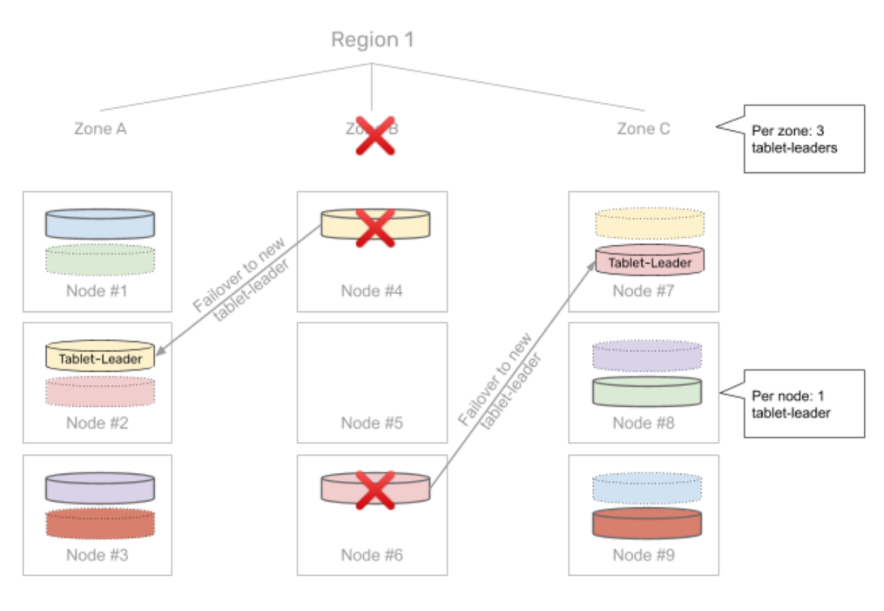
Automatic rebalancing
New leaders evenly rebalanced
After 15 mins, data is re-replicated (if possible)
On failed node recovery, automatically catch up

Slide 34
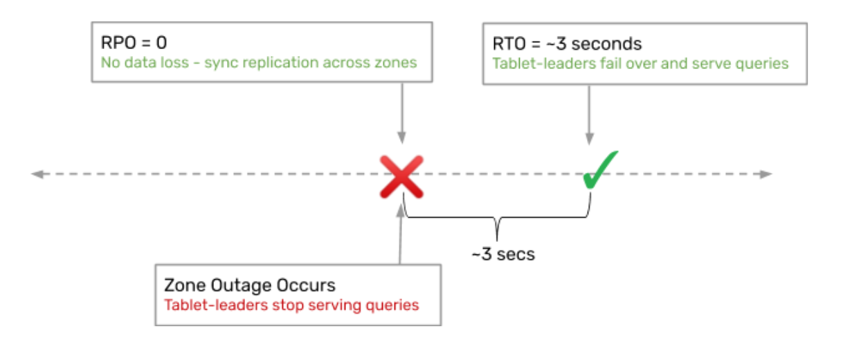
How long to failover in multi-zone setup?

Slide 35
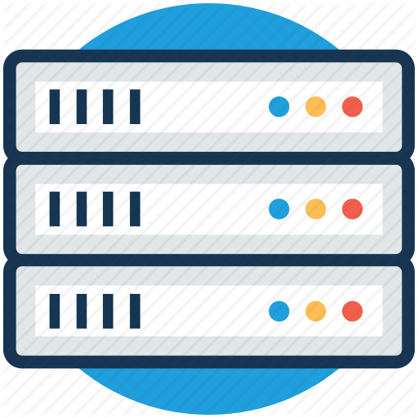
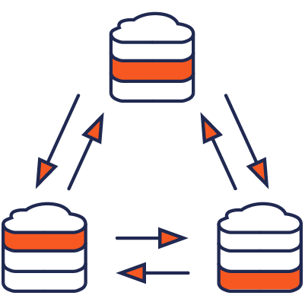
Resilient and strongly consistent across failure domains
Private / Public cloud
Hybrid cloud
Region / AZ / Rack 1
AWS & 1 AZ, 3 Nodes
Region / AZ / Rack 2
Region / AZ / Rack 3
DC2 (on-prem) & 2 Racks, 3 Nodes in each Rack
DC1 (on-prem) & 2 Racks, 3 Nodes in each Rack
Consistent Across Regions / AZ / Racks
Can tolerate 1 Region / AZ / Rack failure
Consistent Across on-premises and AWS. Can tolerate up to 2 Rack failures or 1 DC failure (in RF = 5)

Slide 36

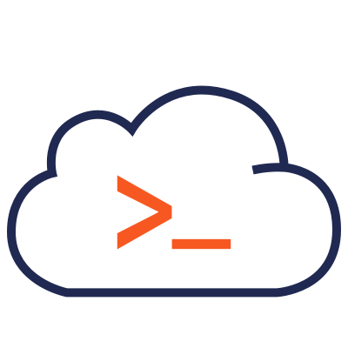
Resilient and strongly consistent across failure domains
1. Single Region, Multi-Zone
2. Single Cloud, Multi-Region
3. Multi-Cloud, Multi-Region
Availability Zone 1
Region 1
Cloud 1
Availability Zone 2
Availability Zone 3
Region 2
Region 3
Cloud 2
Cloud 3
Consistent Across Zones
No WAN Latency But No Region-Level Failover/Repair
Consistent Across Regions
with Auto Region-Level Failover/Repair
Consistent Across Clouds
with Auto Cloud-Level Failover/Repair

Slide 37
Multi-Master Deployments w/ xCluster Replication
Master Universe 1 in Region 1
Master Universe 2 in Region 2
Availability Zone 1
Availability Zone 1
Bidirectional
Async Replication
Availability Zone 2
Availability Zone 3
Availability Zone 2
Availability Zone 3
Consistent Across Zones
No Cross-Region Latency for Both Writes & Reads
App Connects to Master Universe in Region 2 on Failure
Consistent Across Zones
No Cross-Region Latency for Both Writes & Reads
App Connects to Master Universe in Region 1 on Failure

Slide 38
Postgres to Yugabyte Comparison
 | PostgreSQL | YugabyteDB
Use-cases | OLTP, OLAP | OLTP, HTAP
Geospatial | Yes - PostGIS | No (PostGIS in roadmap)
Use as serving tier | Not for use-cases requiring high read IOPS | Yes
Data replication across nodes / regions | Async replication only - master to replicas with unidirectional, multi-master using bidirectional | Sync replication - auto replicate data to newly added nodes and globally stretched clusters. Async replication - unidirectional and bidirectional replication
Scaling queries, data sets | No - vertical scaling only | Yes - vertical & horizontal just add nodes to scale cluster
Scaling concurrent client connections | No - there is a limit on connections per node | Yes - add nodes to increase the number of connections possible, use larger clusters of smaller nodes.
HA - easy multi-zone deployment | No | Yes - deploy across zones with transactional guarantees, RPO=0
HA - handling unplanned outages | No - requires manual setup and intervention to ensure HA | Yes - queries are transparently handled by other nodes in cluster
HA - maintenance (software upgrades, config change, etc.) | No - requires manual steps to perform, issue for large deployments | Yes - transparently handled using rolling upgrades
Resilience - automatic repairs on failures | No - failures require manual intervention | Yes - on an extended node failure, data is automatically re-replicated to other nodes in the cluster
Cloud-Native | No | Yes - run in public or private cloud, k8s, etc

Slide 39
Financial
Customers

Slide 40





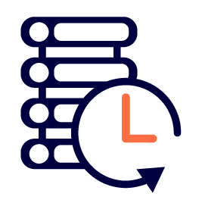
Multinational Financial Services Company
Reasons Yugabyte was chosen
Low Latency
Cloud Independent
Scalability
Geo Distribution
Cloud Native
TCO
HA/Resilience
YB powering website
Customer and Account Management
Untether mainframe
Move to distributed computing for both application and database layers

Slide 41


Financial Services
Low Latency
< 10ms for batch writes & range queries
10B ops per day; 60 TB dataset; handling 200K+ transactions / sec at peak
Multiple AZs, multiple regions
Achieved lower TCO and complexity by replacing Redis and AWS RDS
Scalability
Geo Distribution
Provides market data as APIs and microservices.
Tick by tick and bid/ask data
Customers include BlackRock, Charles Schwab, TIAA, and SoFi
TCO

Slide 42
Support

Slide 43
support.yugabyte.com
Dedicated support team in covering all of NA region
Expanding internationally, with centers in EMEA and APJ
24x7 on call for production down issues

Slide 44
Severity Levels and Response Times
Severity | Target Response Time & Effort
Severity One means Customer’s production server or other mission critical system(s) are down | 1 Hour
Severity Two means that major functionality is severely impaired | 4 Business Hours
Severity Three means a partial, non-critical loss of functionality | 8 Business Hours
Severity Four means general usage questions and cosmetic issues, including errors in the Documentation | Next Business Day
https://www.yugabyte.com/support-policy/

Slide 45
Monitoring/Administration

Slide 46
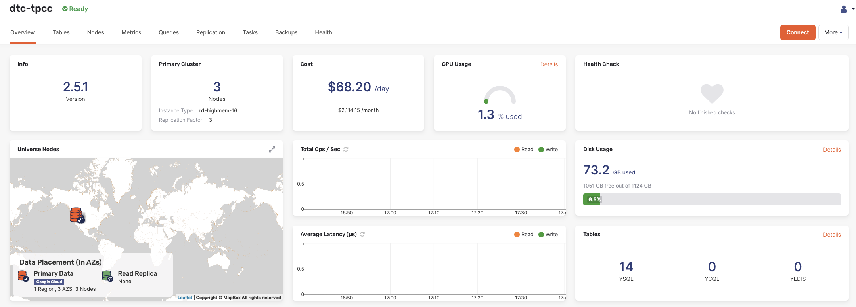
Introduction to Yugabyte Platform
Built-in monitoring and alerts
Configuration & change management
24/7 Technical Support
Management platform for building your private DBaaS
Cloud Native deployments on public & private clouds
Robust automation for Day 2 ops (Backups/recovery, scale up/down, rolling upgrades)

Slide 47
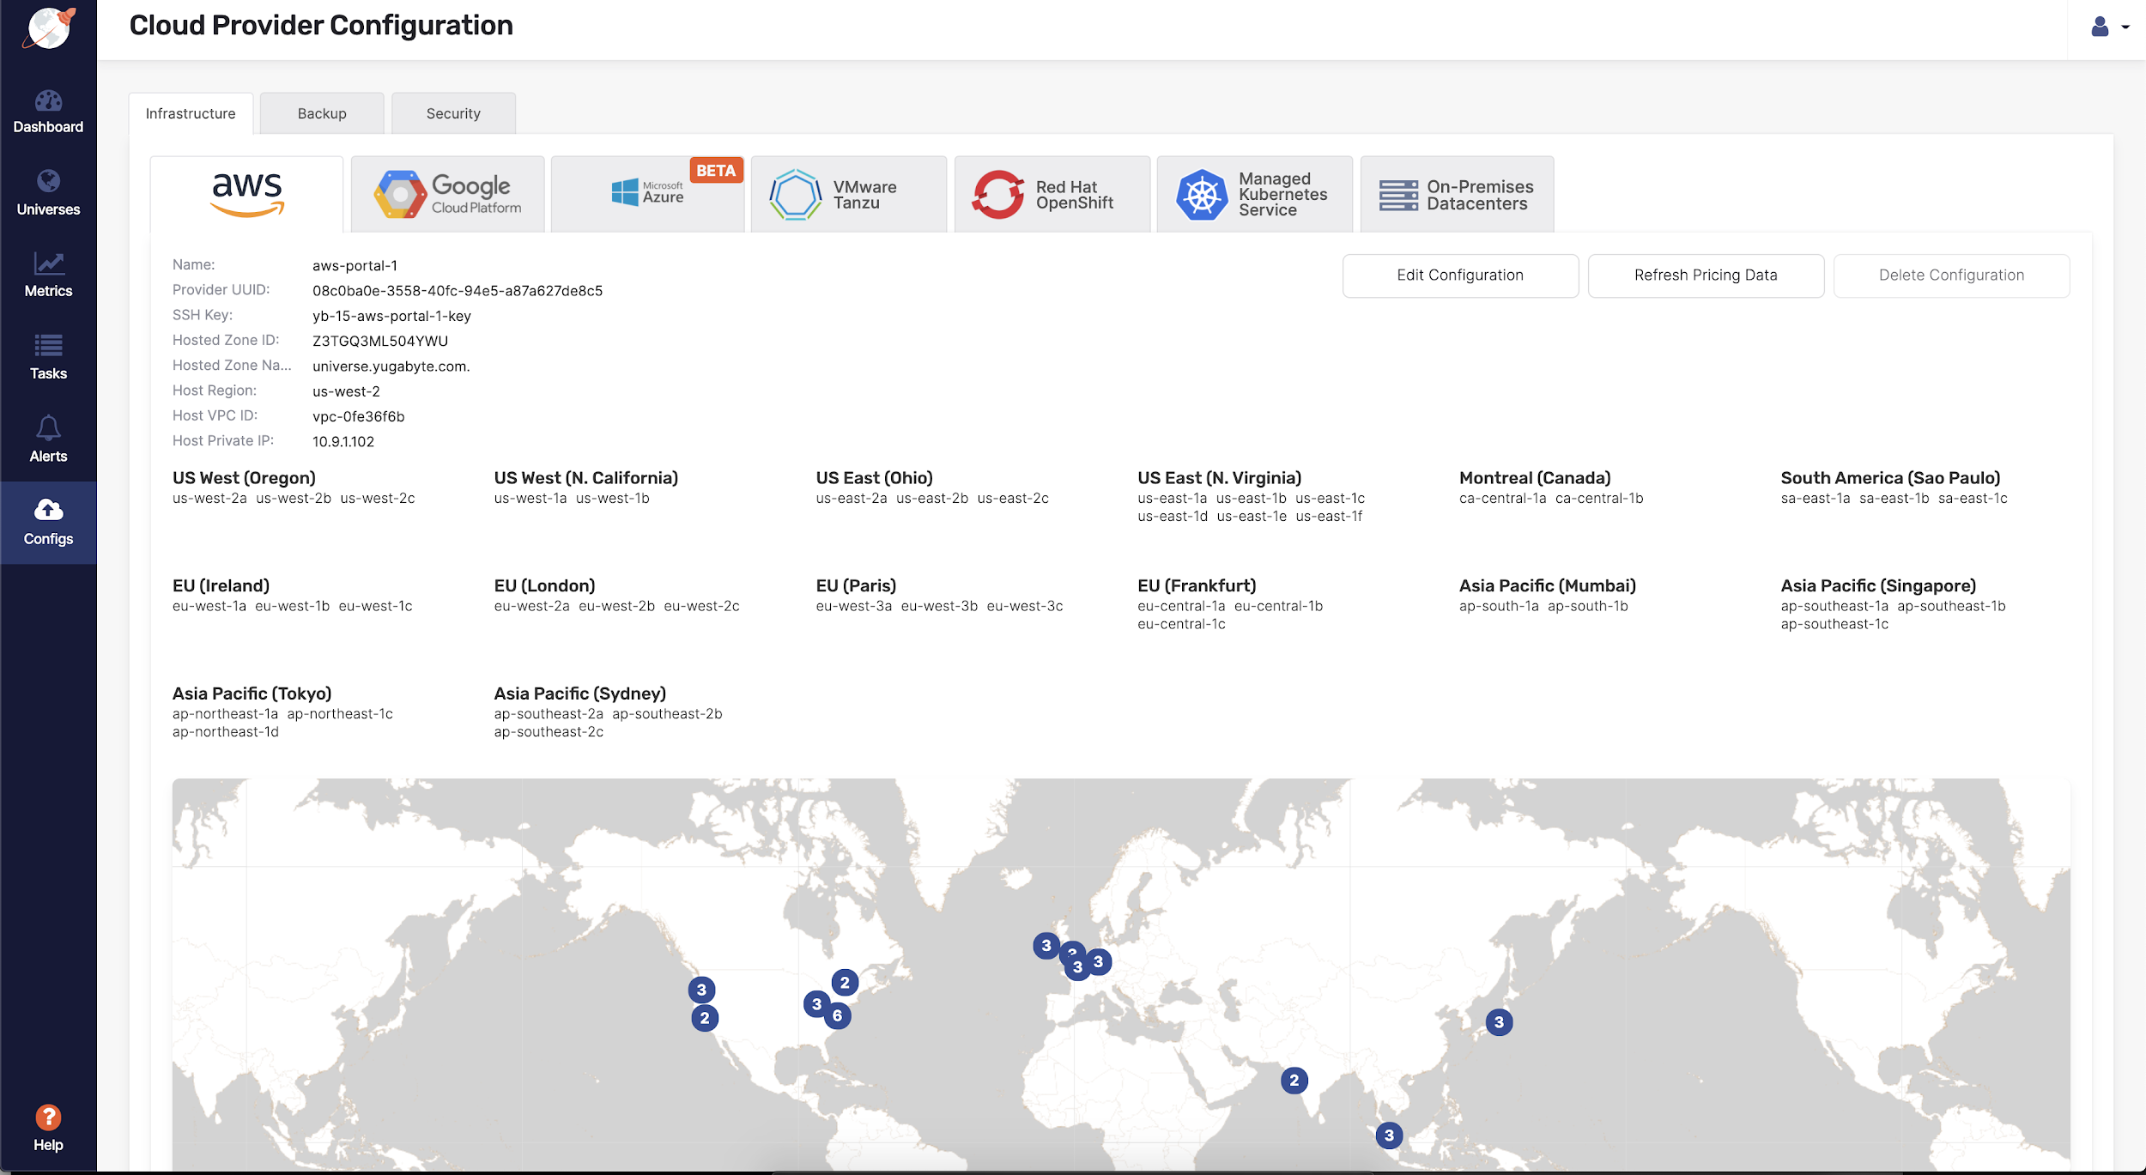
Deploy on every Cloud/Container

Slide 48
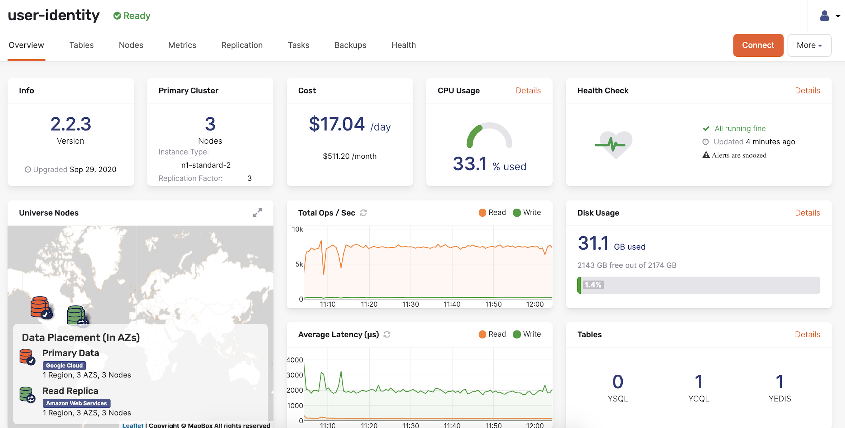
Manage and monitor universes

Slide 49
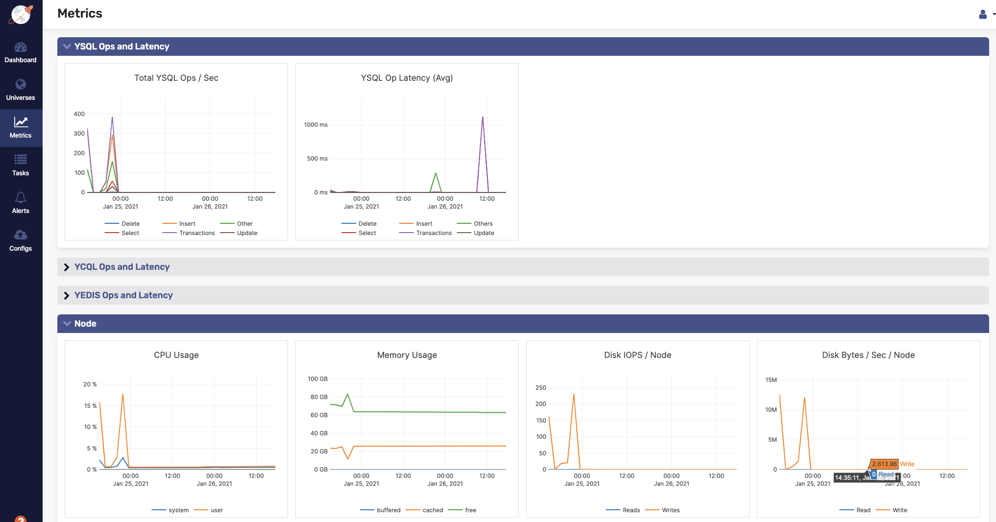
Metrics - SQL Ops and Latency

Slide 50
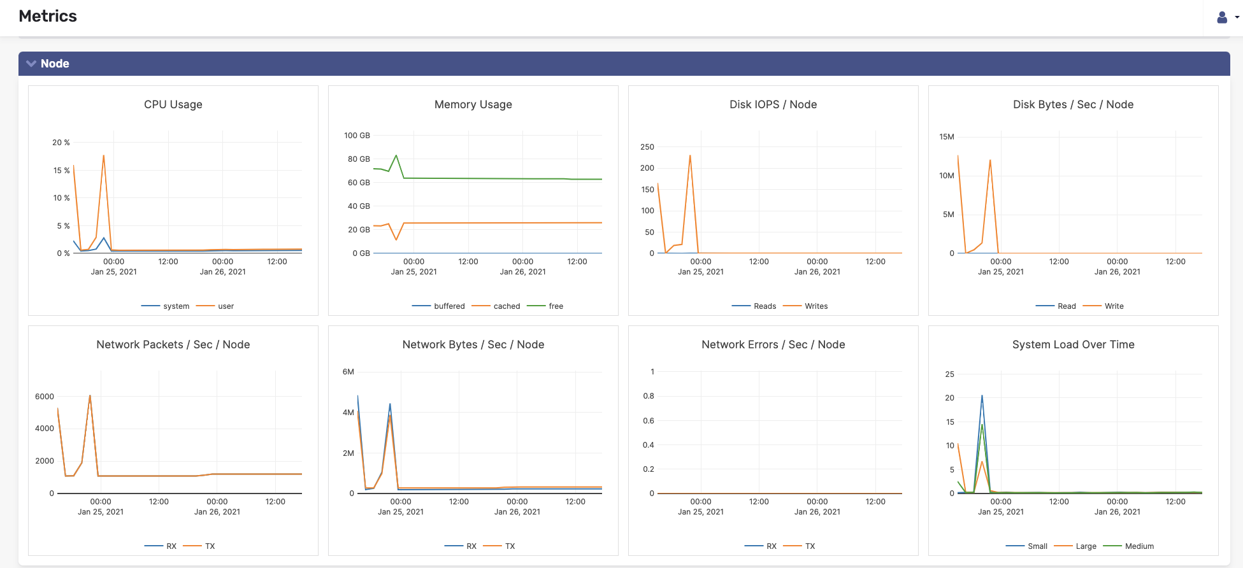
Metrics - Nodes

Slide 51
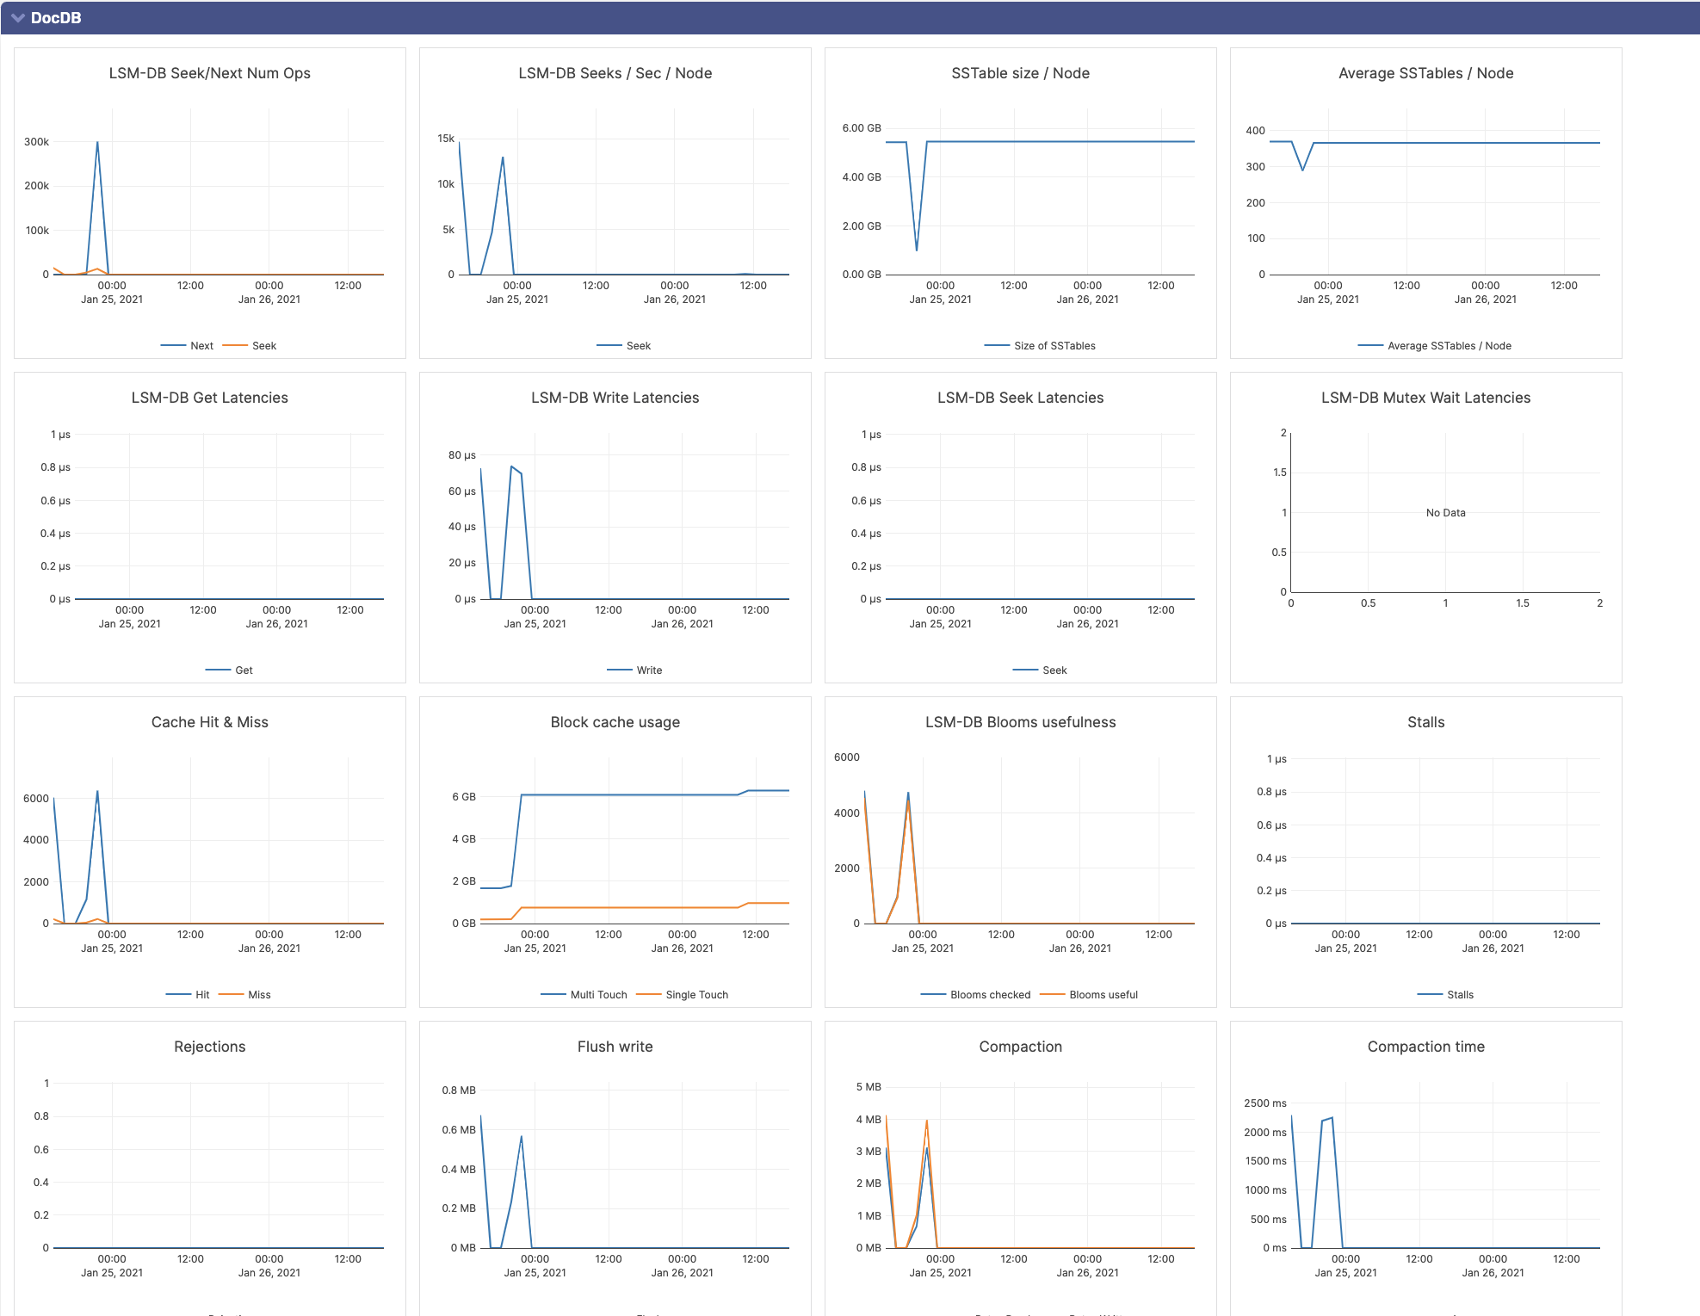
Metrics - DocDB

